Slide 1

Notes:
Add the “powered by Veolia” line

Slide 2
Jan
Bus Transit Committee
December 17,2013

Slide 3
Briefing Agenda
MetroCard Issues; Follow Up
Technology Project
2013 Review
2014 / A Look Ahead

Slide 4

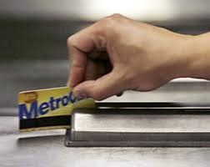
MetroCard Issues

Slide 5
MetroCard Solutions
Farebox Performance
Upgraded Maintenance Program
  Farebox Maintenance Task Force,
  Added technician
  Accelerated PM Program
  Head Reader Cleaning Cards
  Other Diagnostic & Repair Tools

Slide 6
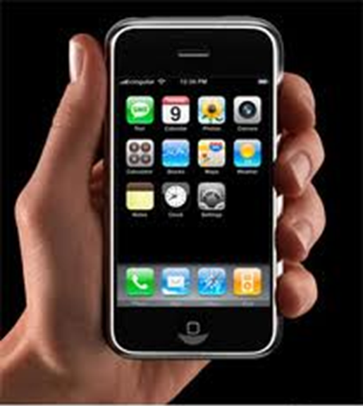
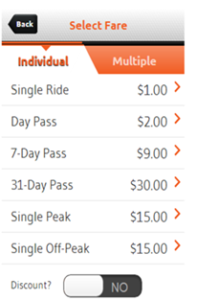

MetroCard Solutions
Mobile Ticketing
Smart Phone App
Rollout in early 2014
Bypasses MTA
Potential for Interline Transfers

Slide 7

Bus Technology Project

Slide 8
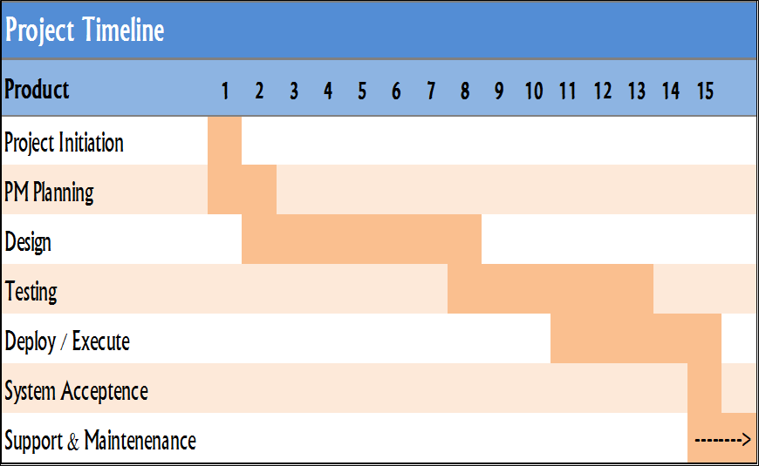
Project Timeline

Slide 9
Automatic Vehicle Location
Situational Awareness in Real Time

Slide 10
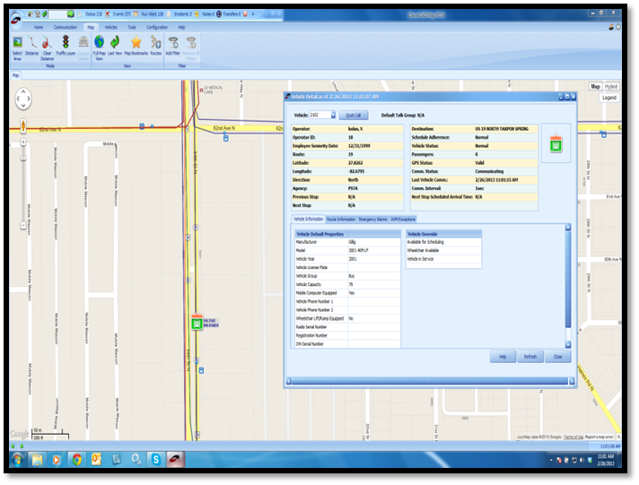
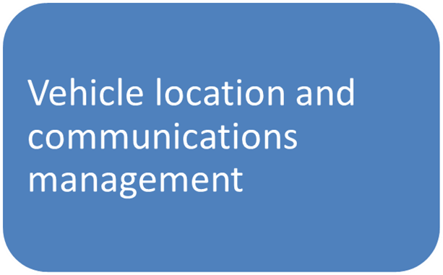
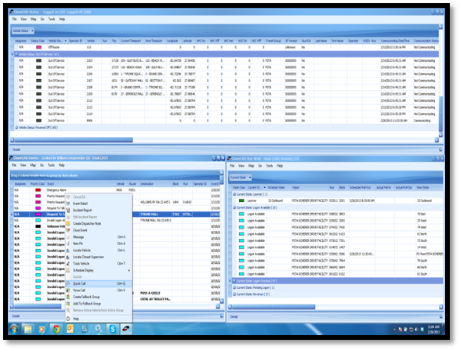
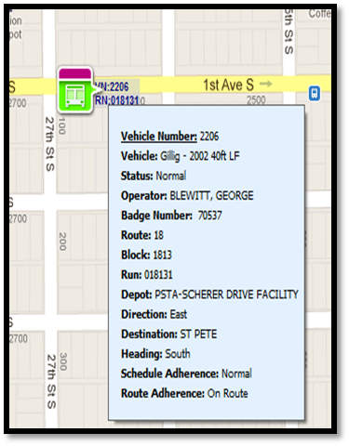
Computer Aided Dispatch
Helping Command Center Make Decisions

Slide 11
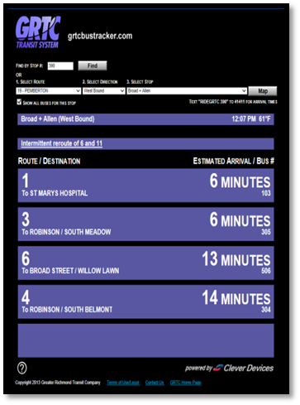
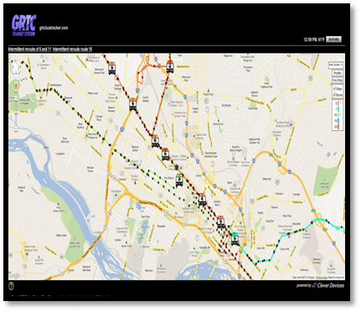
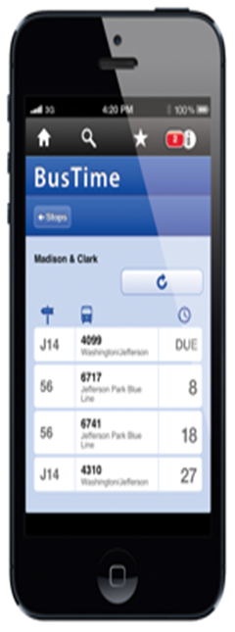
Real-time vehicle location and predictive arrival information for passengers

Slide 12
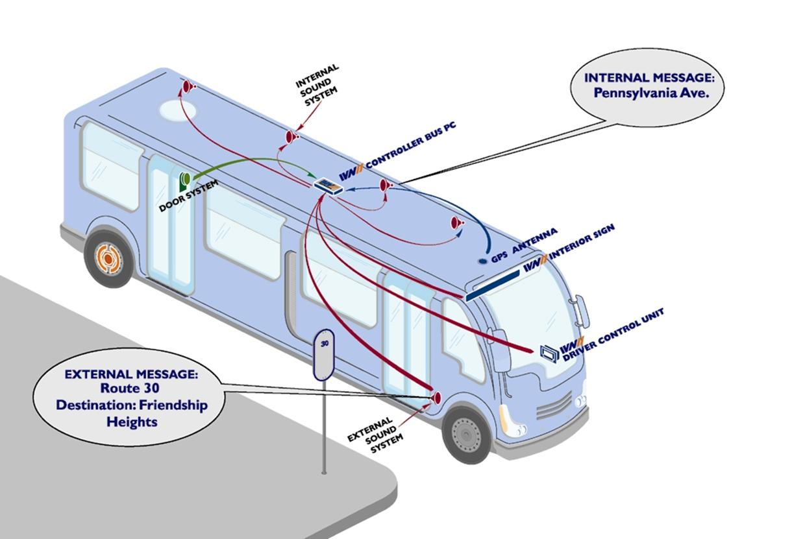
Vehicle Location in Audio Format

Slide 13
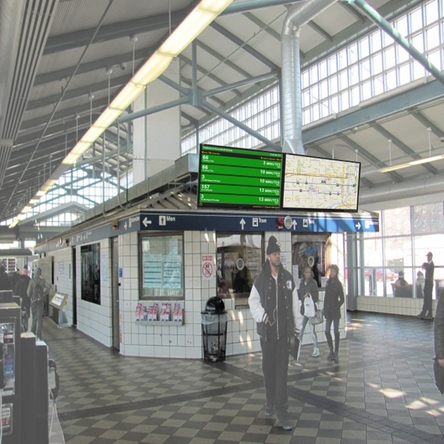
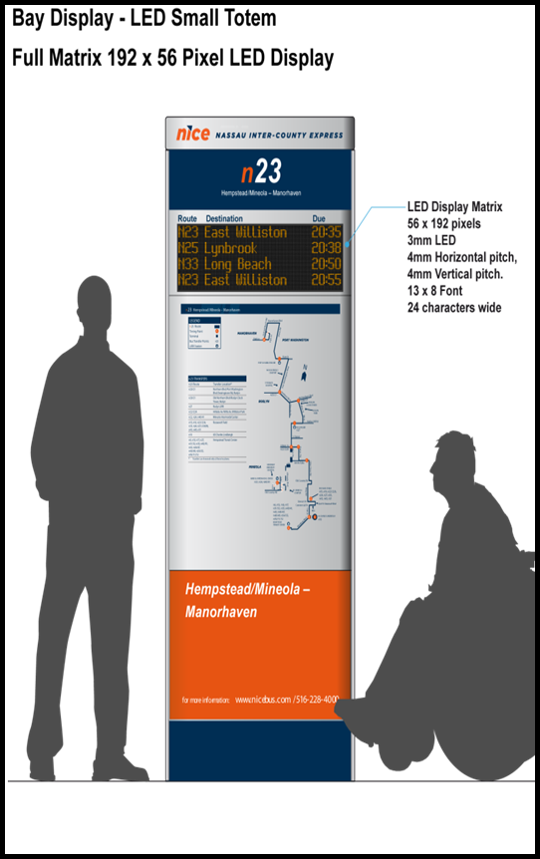
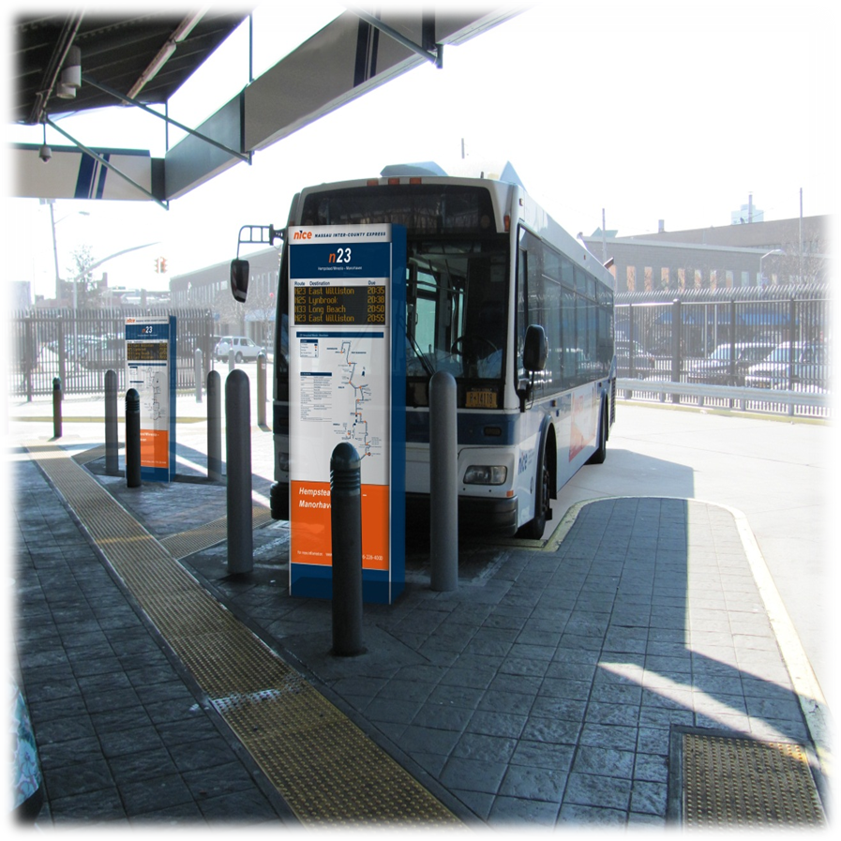
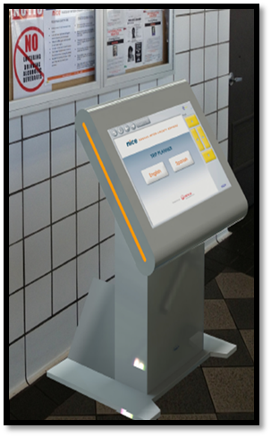
Hempstead Transit Center
Various Customer Interfaces that communicate real time conditions;
Arrivals/Departures

Slide 14
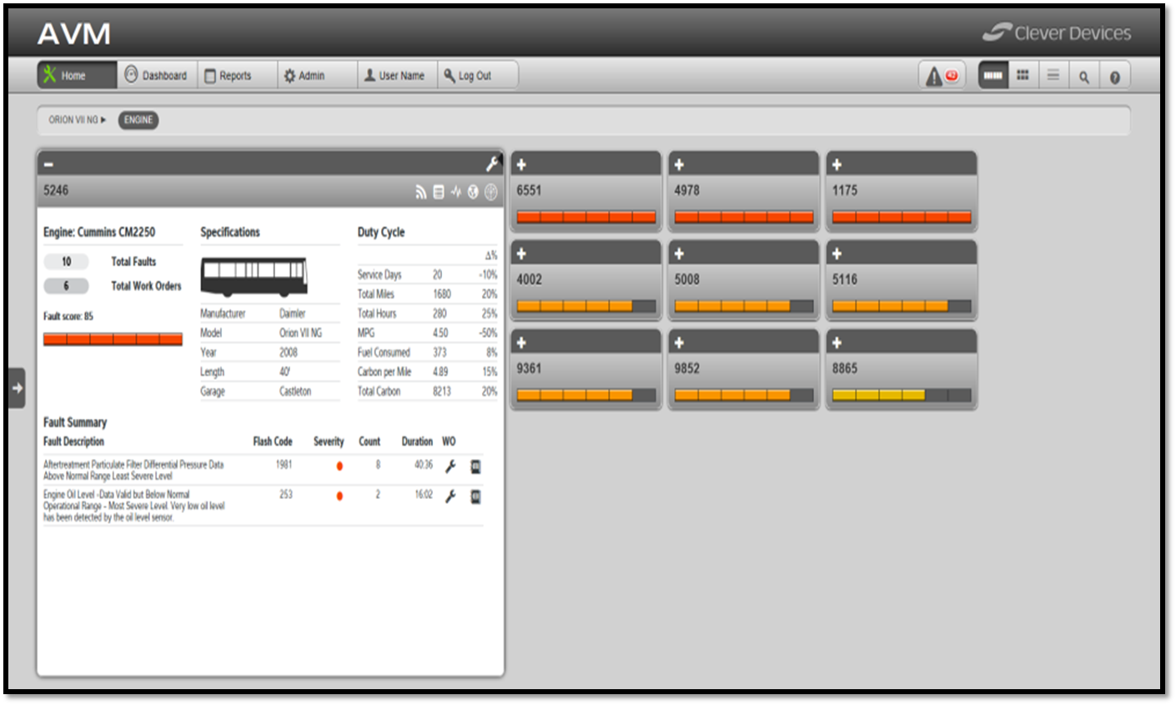
System will allow us to monitor the health of the fleet, even when it’s on the street

Slide 15
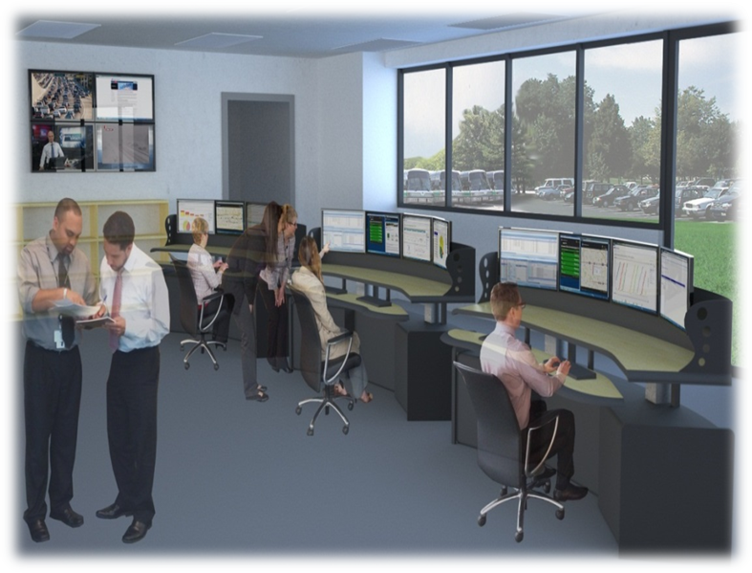
New State-of-the-Art Command Center
Managers can see situations develop in the early stages
And also see where all available assets are located

