Slide 1

2013 Accomplishments

Slide 2
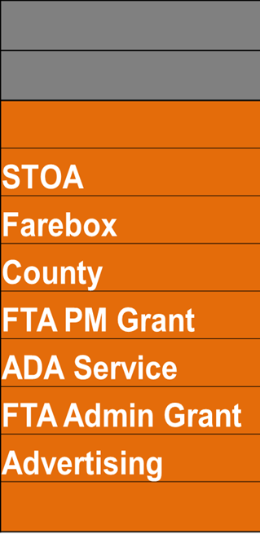
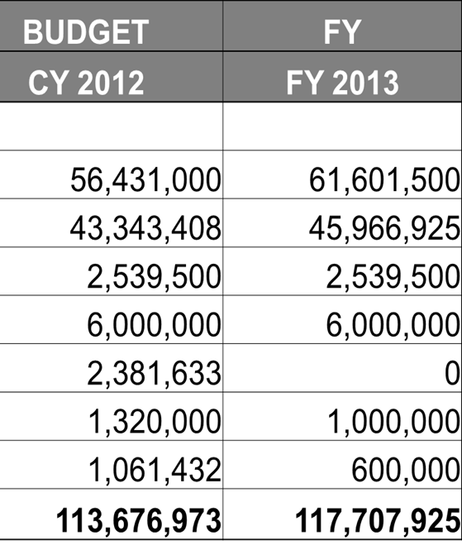
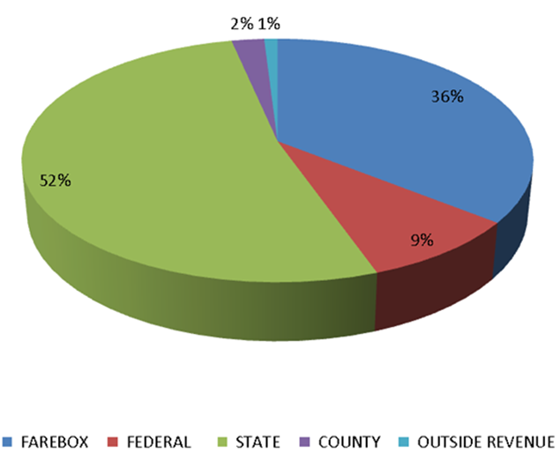
Funding
Notes:
Title Needs Work

Slide 3

New n4X Routes Cuts Commute by 20 Minutes
New n6X Routing from HTC directly to NCC
New n87 Service from Hicksville to Jones Beach
More Frequency on Heaviest Traveled Routes n6, n4, n20
Increased Service Hours on Able-Ride

Slide 4
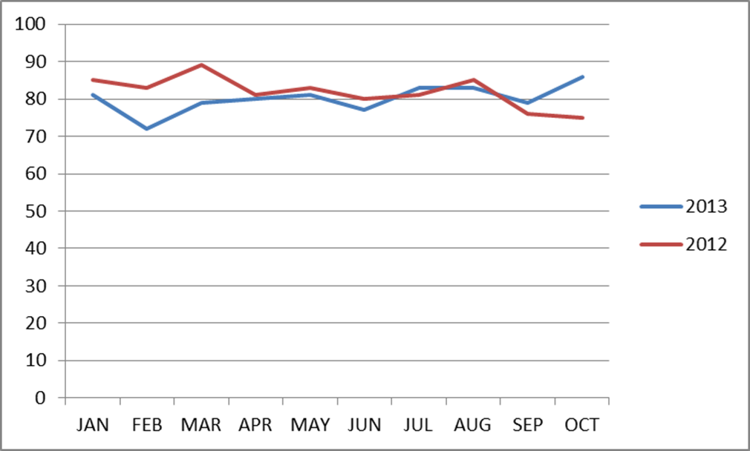
Fixed Route Ridership & Revenue
Ridership YTD 2013 VS 2012
23.9 Million VS 24.7 Million

Slide 5
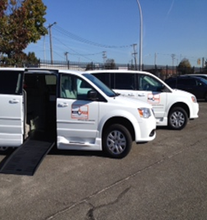
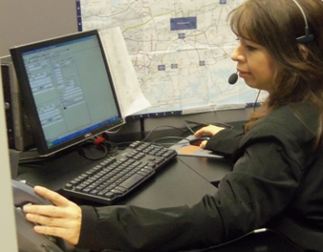
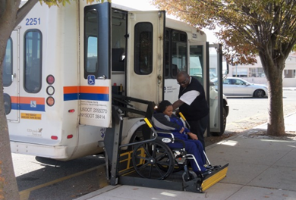
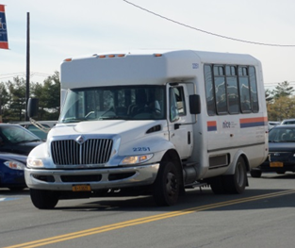
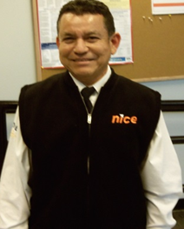
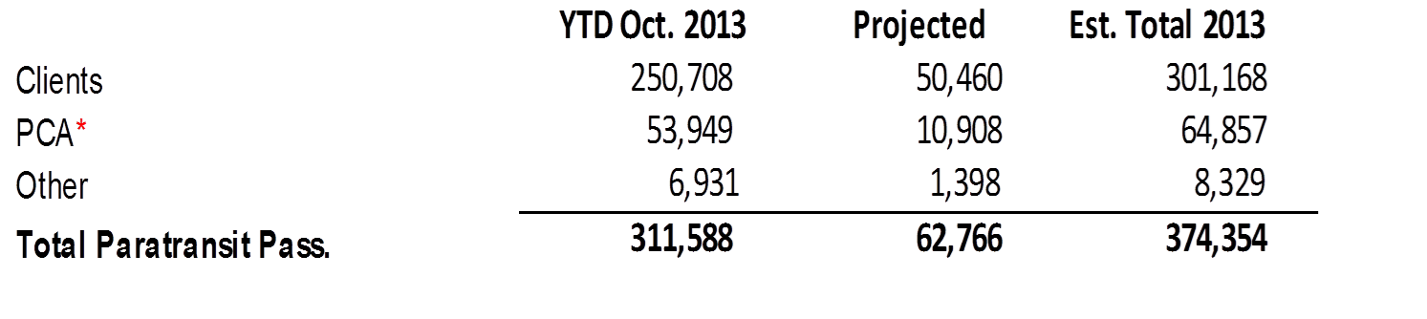
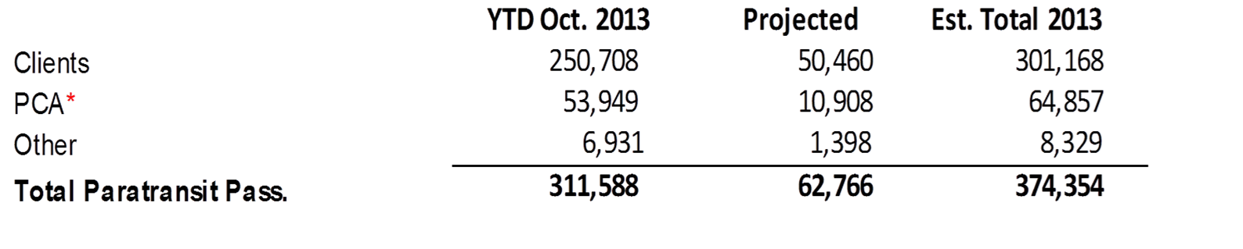
Able Ride Trips

Slide 6

We’re Listening
22 Hours of Public Open House Meetings
4 BTC Meetings / 6 TAAC Meetings
12 Press Releases (thru 9.30)
260,000 Calls Answered (thru 9.30)
10 Customer Outreach Events
4900 Customer Comment Responses (thru 9.30)

Slide 7
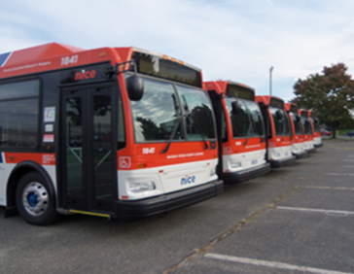
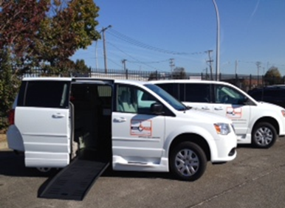
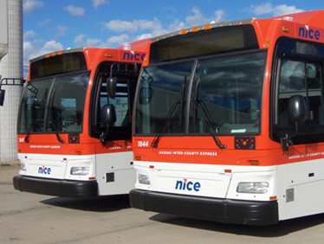
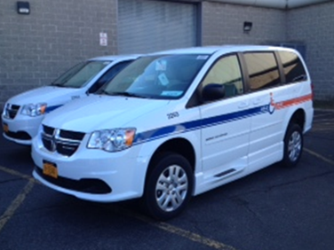
New Vehicles
45 New Orion VIIs
28 Able-Ride Vans
25 New Non-Revenue Vehicles

Slide 8
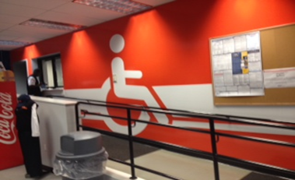
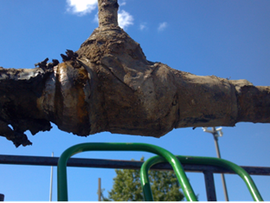
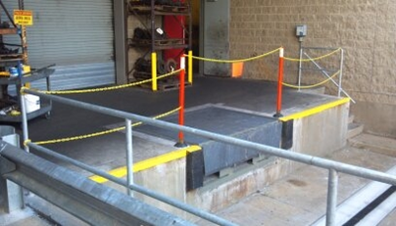
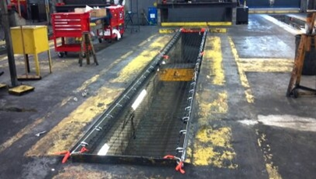
Facility Upgrades & Repairs
Loading Dock Upgrades for Safety & Efficiency
Safety Netting for all Service Pits
New Koni Lifts for all 3 Facilities
Painting & Ceiling Tiles for RVC
Interior Graphics for Stewart Ave
Curb Repair & Paving @ Mitchel Field
Emergency CNG Repair

Slide 9
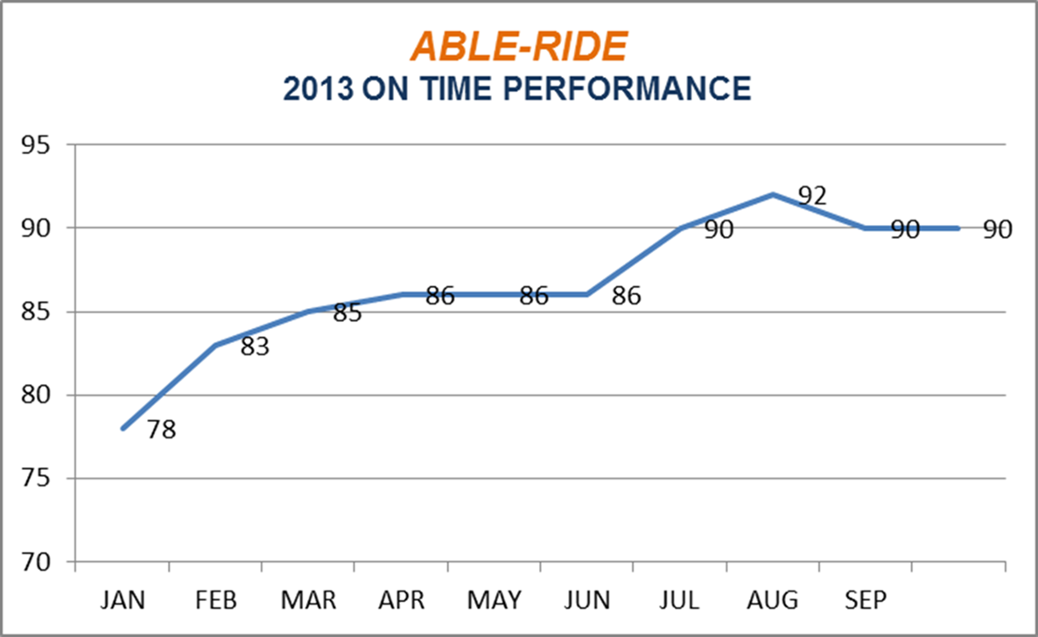
Able-Ride OTP

Slide 10
FTA Reviews
FTA Triennial 2013 with No Findings
Stellar Procurement Review
Excellent Drug & Alcohol Review
Title VI; No Findings or Deficiencies

Slide 11
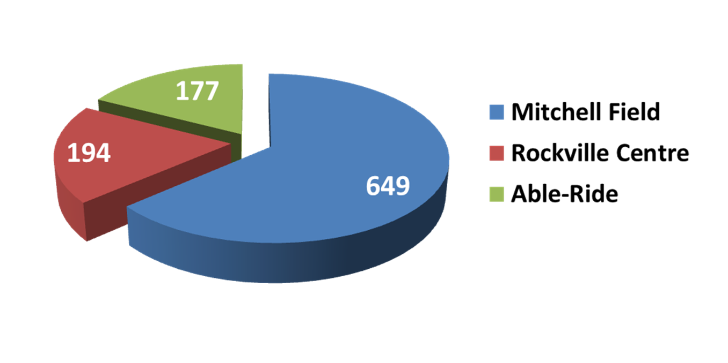
Current Employee Count
Increased Head Count to 1022 Employees
Fixed-Route Drivers Hired in 2013: 47
Able-Ride Drivers Hired in 2013: 38
Maintenance Employees Hired in 2013: 59

Slide 12

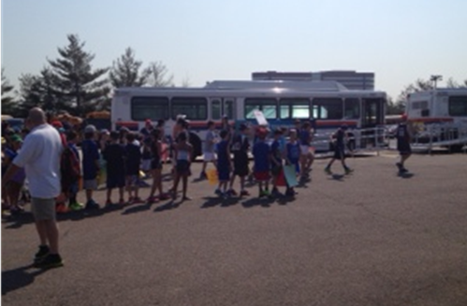
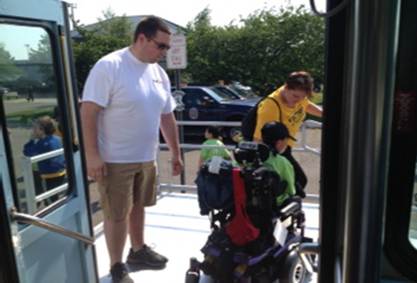
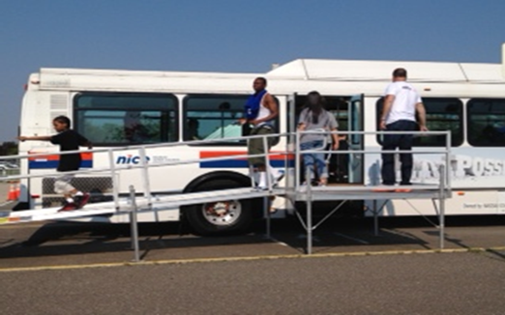
Supported the Victory Games;
Financially, Manpower & Equipment
60+ NICE Bus Employees Volunteered

Slide 13

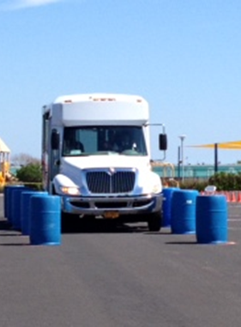
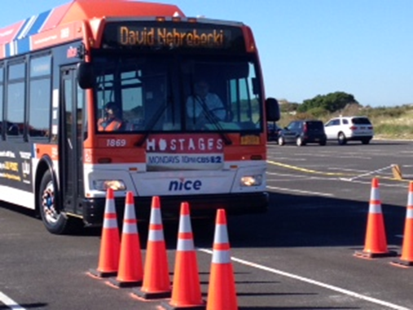
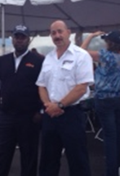
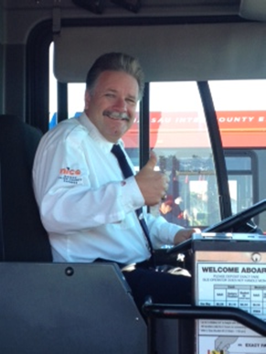
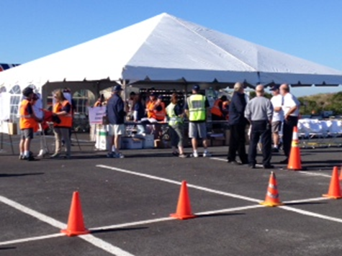
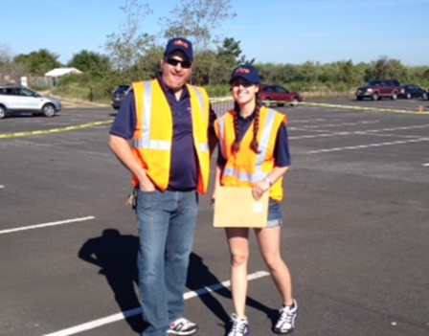
Successful State & Local Roadeo
Pat Piegari NICE Bus
State Champion

Slide 14




Social Media Campaigns
Launched Separate Facebook Pages for Fixed Route and Able-Ride
Launched YouTube Channel
Launched Twitter & Instagram
Weekly/Daily Website Updates with New Content, News & Features

Slide 15



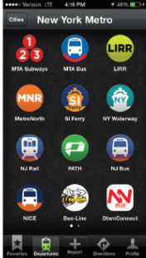

Customer Engagement Programs
Countdown to Jones Beach
Read While You Ride
Latoya Travels
Nassau County Hot Spots
App Showcase
Enhanced Google Trip planning features

Slide 16
2014 / A Look Ahead

Slide 17
2014 / A Look Ahead
Stabilization of service levels
Focus on;
  On-Time
  Safety
  Better scorecard format
New technology implementation
Largest system in the Country to launch mobile ticketing

Slide 18
2014 / A Look Ahead
Grants
  Replace fixed route and paratransit buses
  Infrastructure Improvements
Funding Available to Nassau County
  Fares
  State Appropriations
Budget and Annual Plan Process
  Recommendation to Committee in February
  Committee action in March

Slide 19
Thank You
Questions and Comments

